Slide 1



What makes a LinkedIn post good
SANIKA ACHAREKAR

Slide 2
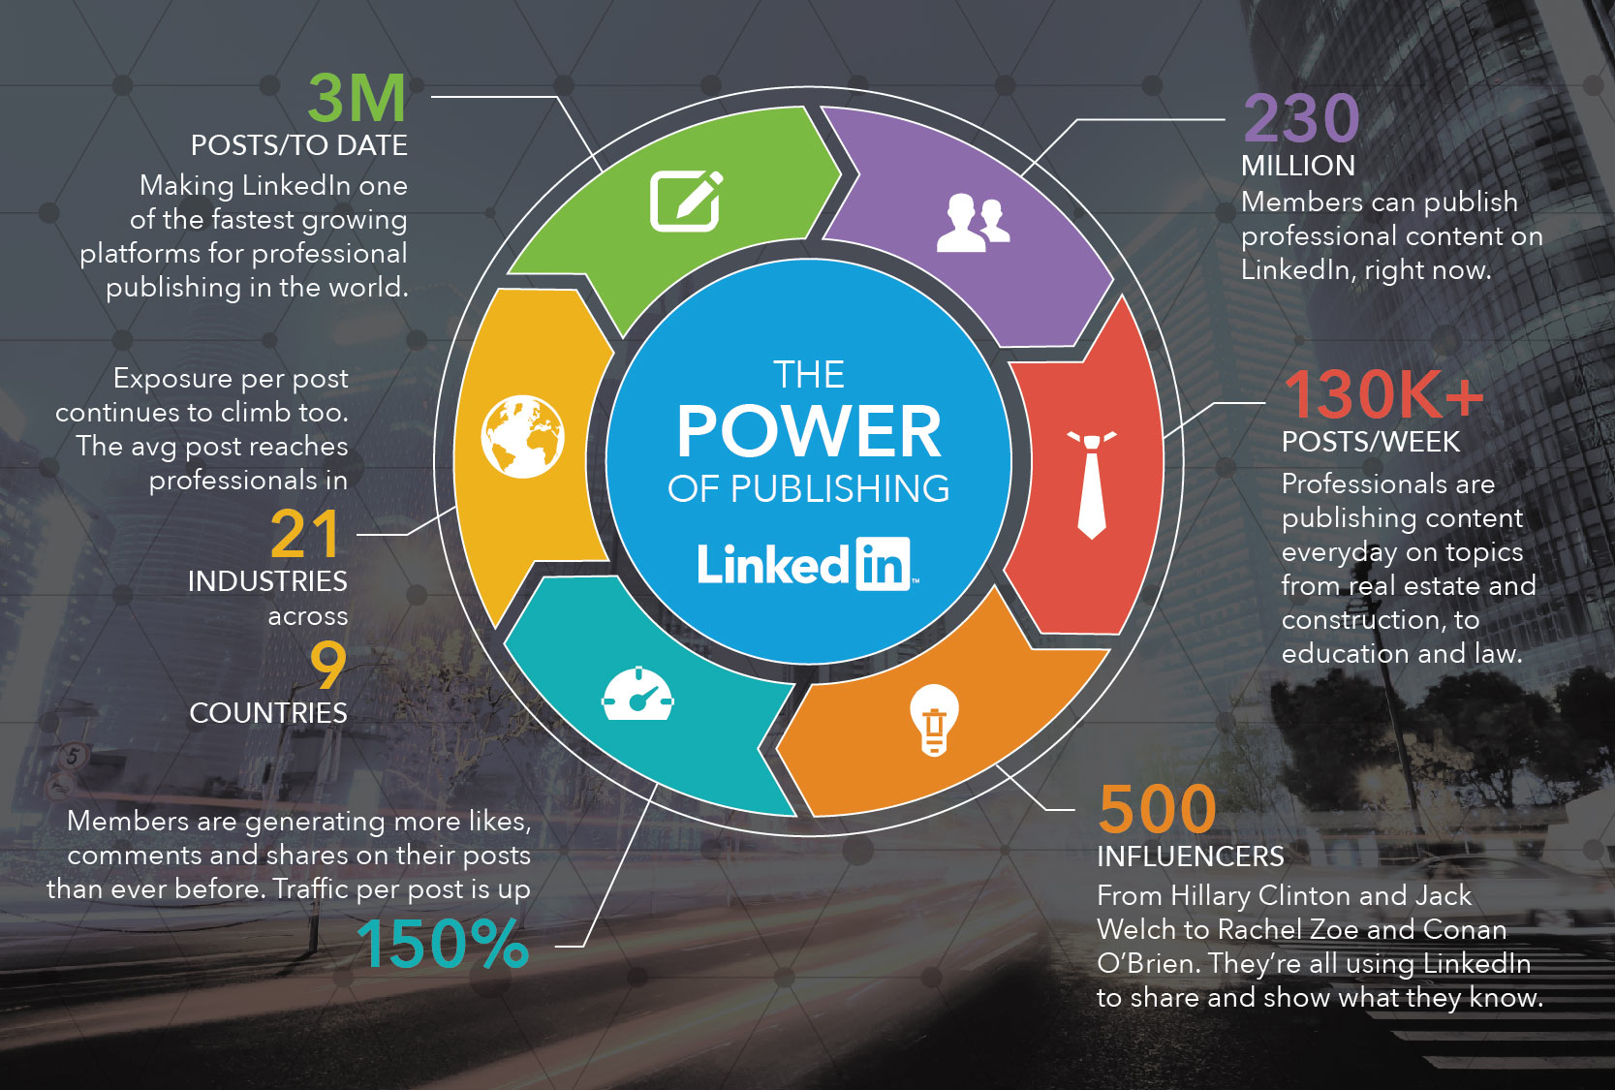
Introduction
LinkedIn is a popular social media platform for businesses to build relationships with their clients and prospects.
By sharing stories and advice through posts, companies can increase their credibility and trustworthiness.
Many "LinkedIn experts" offer services to help companies improve their visibility on the platform.
To increase business revenue, it's important to understand what makes a good post on LinkedIn and how to create quality interactions with potential customers.
Numbers say a lot!!

Slide 3
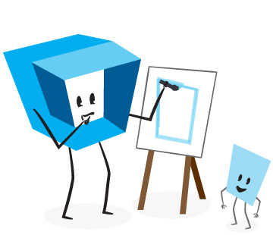
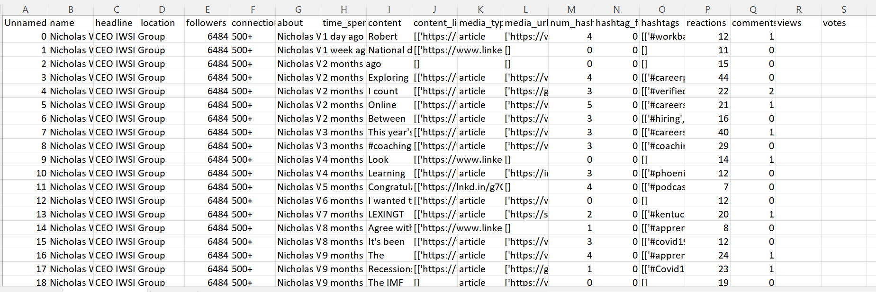
Data description
Database Source: Kaggle
Number of Variables: 19 Total record count: 34012

Slide 4
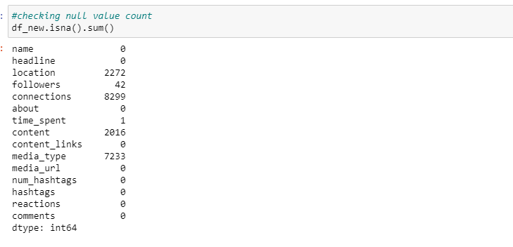
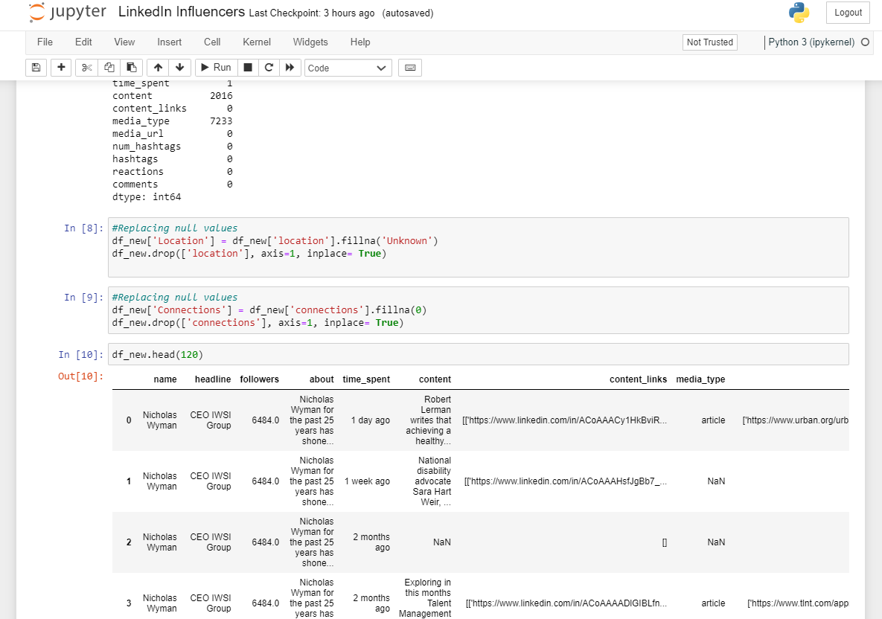
Data Cleaning: Removed columns: ‘Unnamed,’ ’hastag_followers’, ’views,’’votes’
Checking the null values count :
Replacing null values:
Null checks

Slide 5
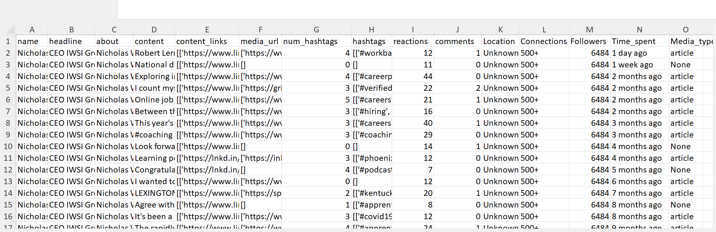
After cleaning the data
Final cleaned data
Number of Variables: 15
Total record count: 31996

Slide 6

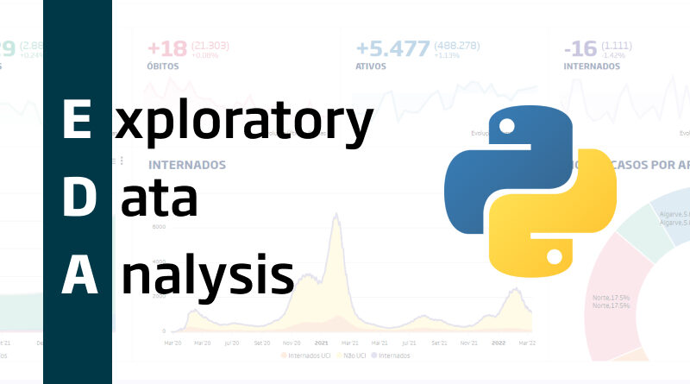
Methodologies

Slide 7
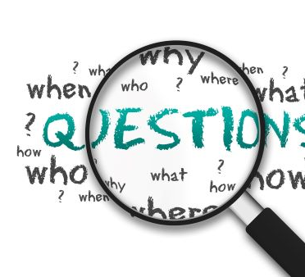
Research questions

Slide 8
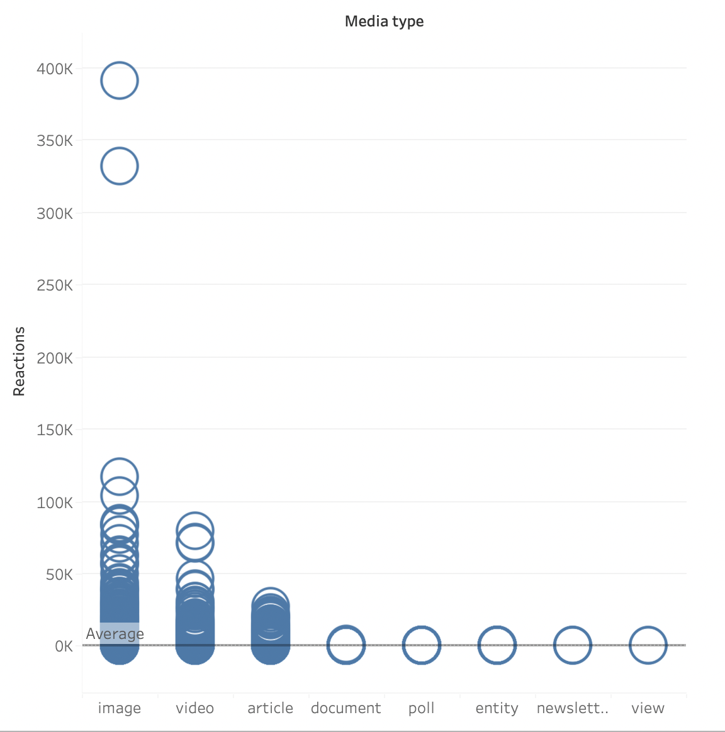
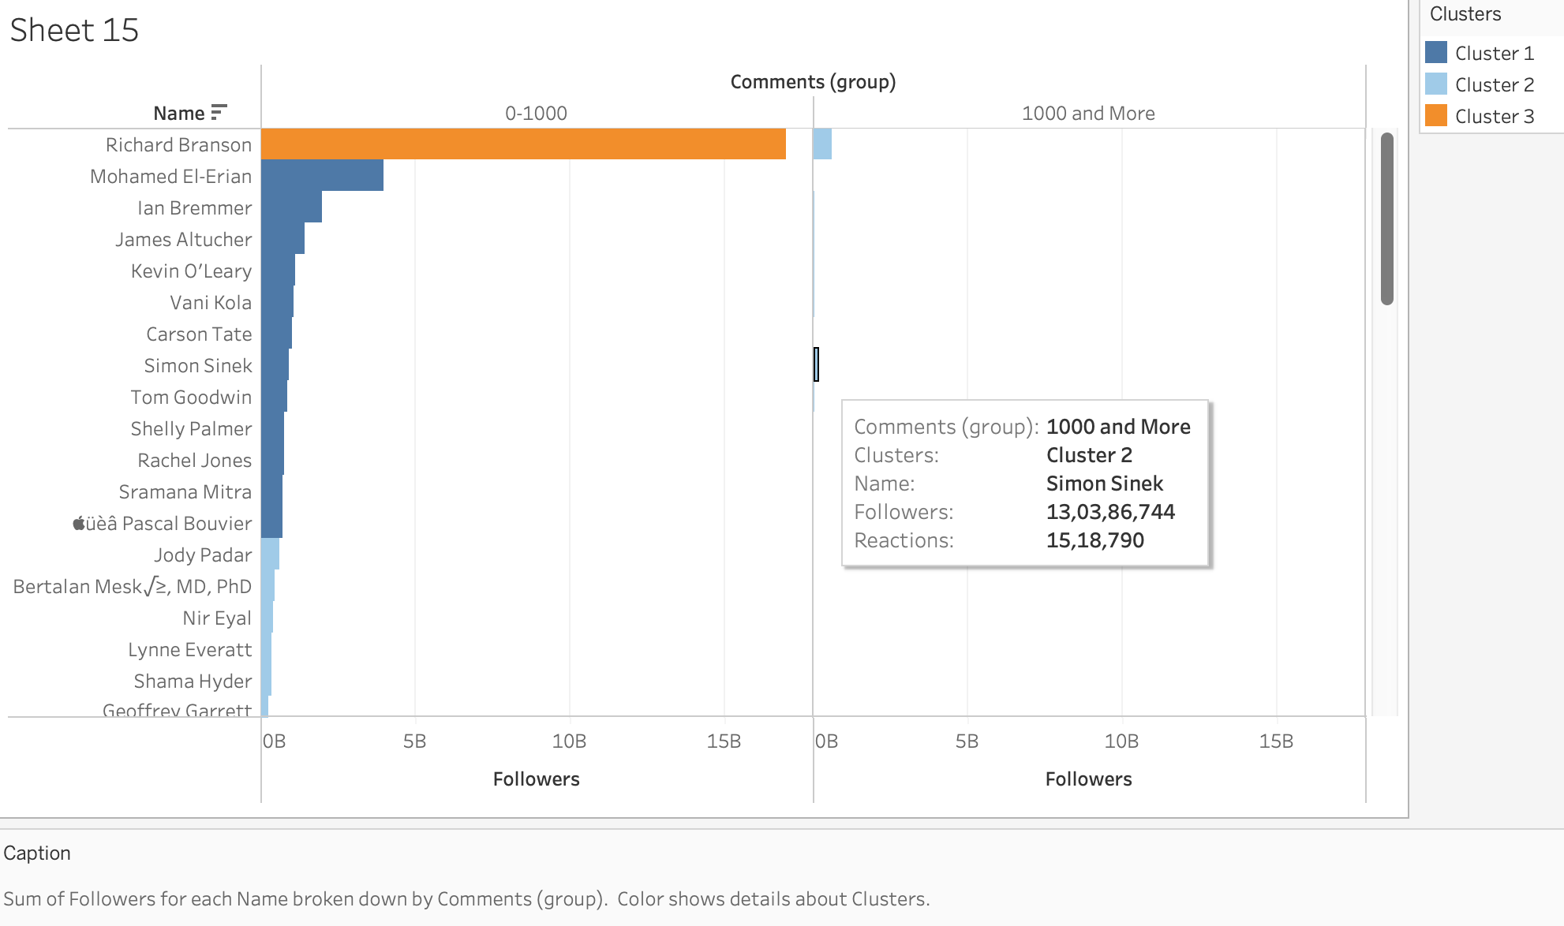
Q1: Based on historical data, can we predict which media types (e.g.,images, videos, text) will receive the most reactions in the future?
Image, Video and Article will receive the most reactions in the future.
Q2: Can we predict the number of views a piece of content will receive based on the number of followers and connections the author has? (With an exception case- where anyone with fewer followers has more reviews).

Slide 9
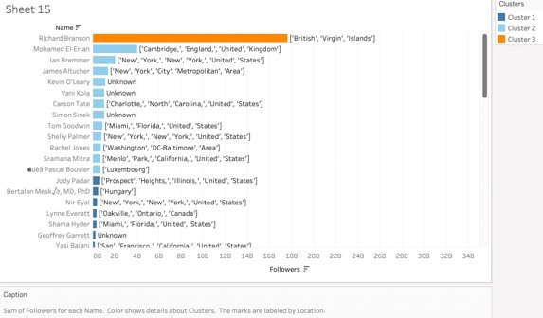
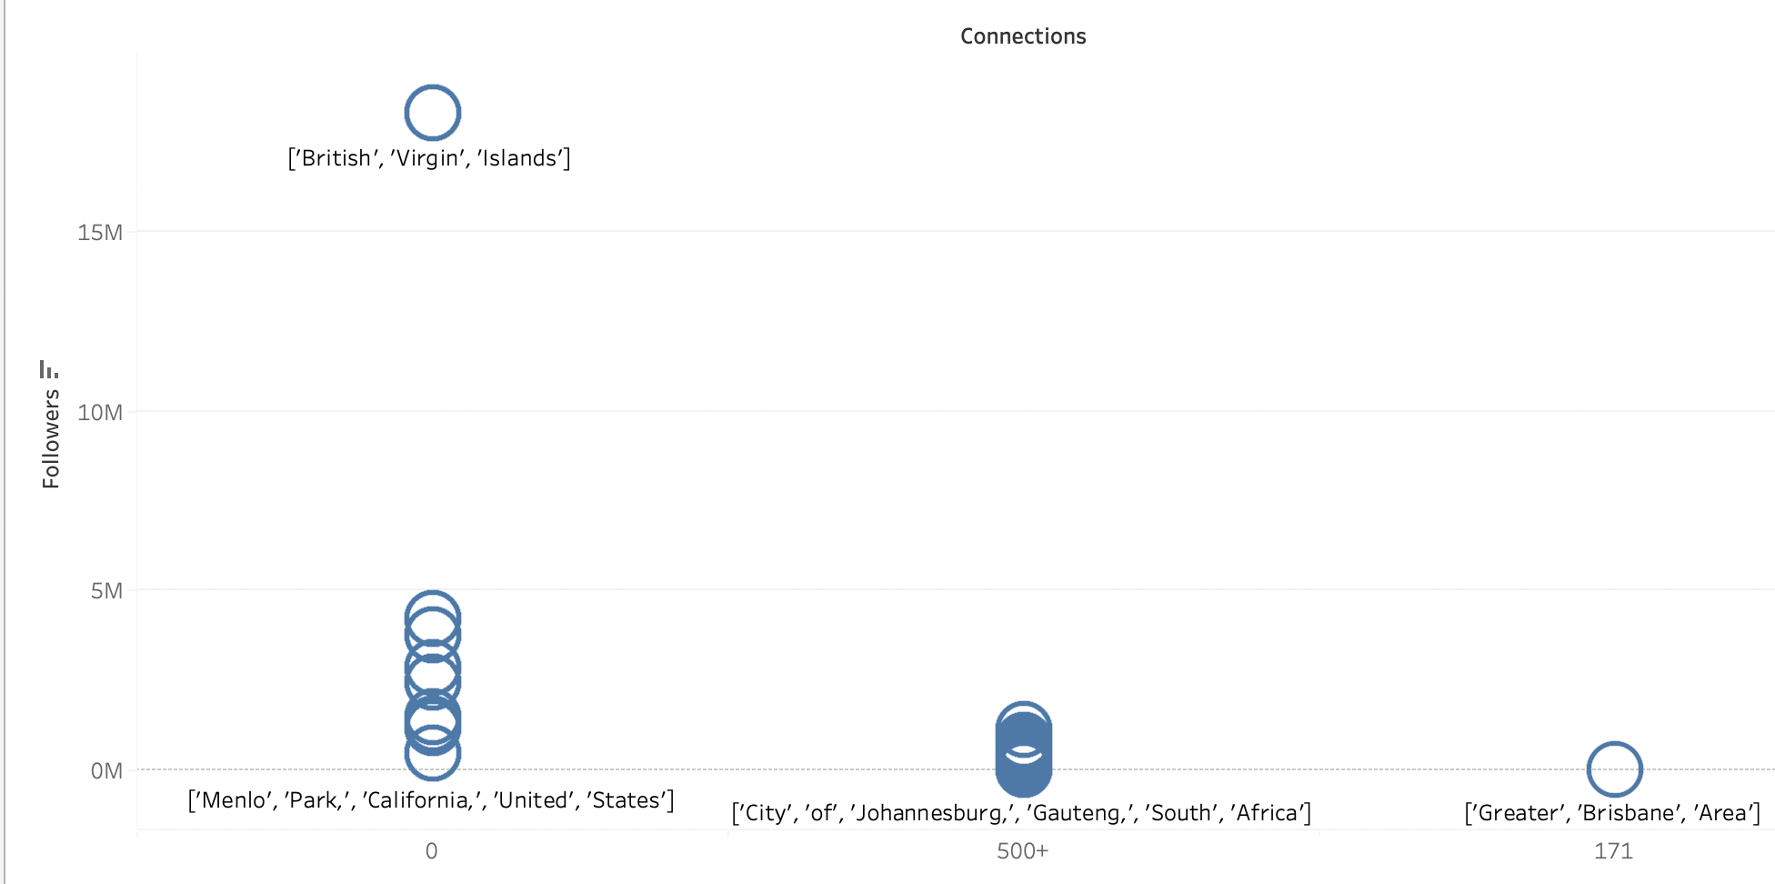
Q3: What is the distribution of followers and connections across users? Are there any patterns in terms of location?
- The data for the connections were Sparsed. There were three types of connections 0, 171 and 500+, out of 34012 records.

Slide 10
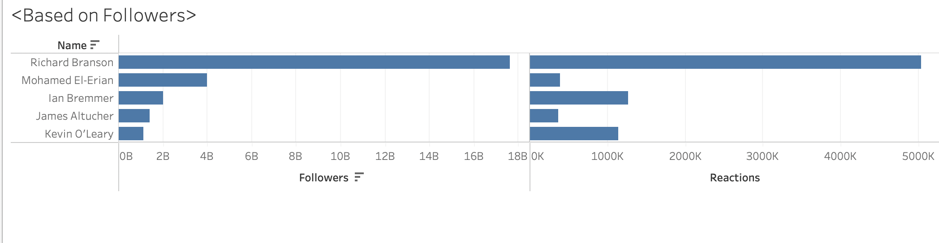
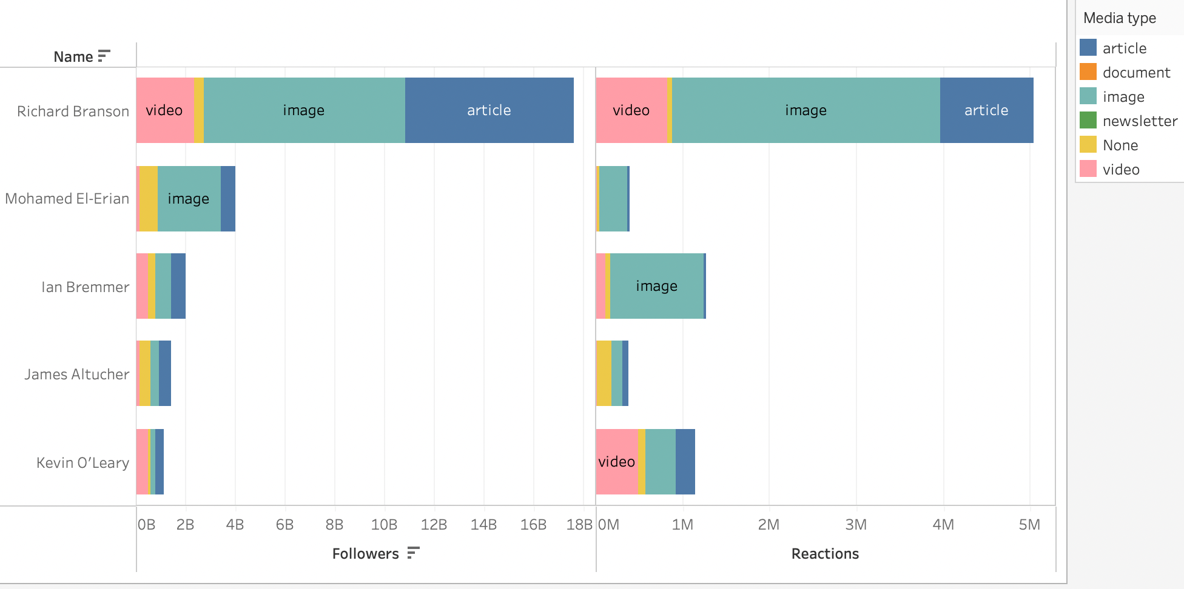
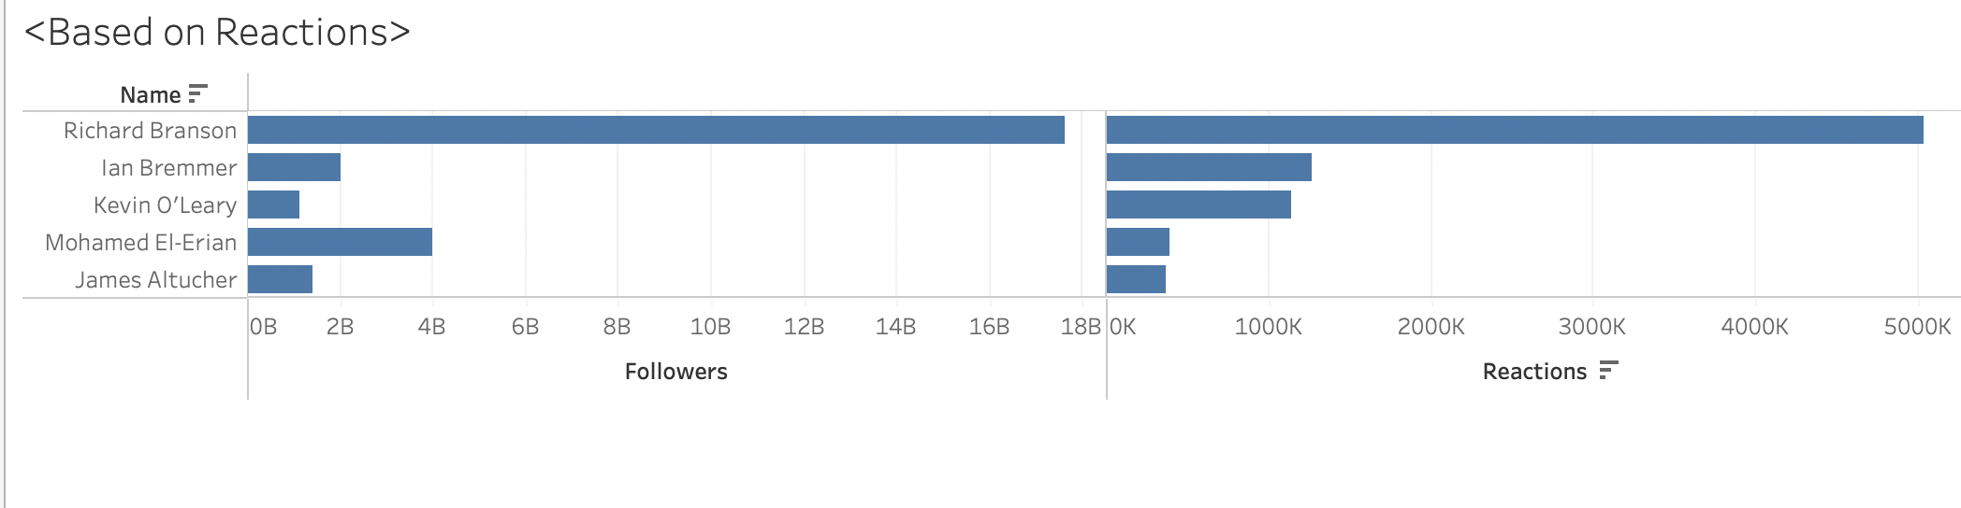
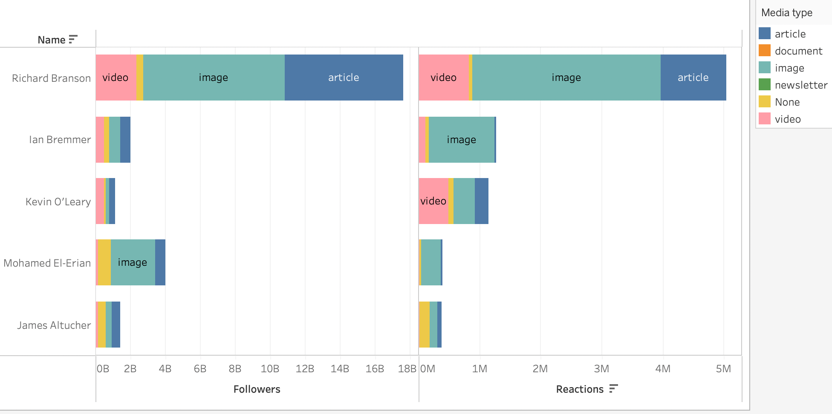
Q4: What characteristics distinguish the top 5 from the rest?
Reactions to the post and its Media type
Image 1- Based on followers and media type of the content posted.
Image 2- Based on reactions and media type of the content posted.

Slide 11
Result and discussion
conclusions
Visual content like images, videos, and articles perform better on LinkedIn. Follower and connection distribution is diverse and not location-dependent.
Top posts stand out due to medium type and reactions received.
Other factors may impact post success, including an exception where fewer followers can still result in more views.
Creating engaging Visual content and posting on the right medium are key to LinkedIn post success
Post media type and reactions are critical factors.
Content Quality and Relevance are important.
Followers count may not be the most significant predictor of success.

Slide 12


